Slide 1

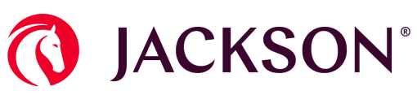
Testing Transformation
Bounteous Proposed POC
SEPTEMBER 2026

Slide 2
CONTENTS
01
02
03
The Opportunity & Proposed Solution Recap
Proposed Proof of Concept
Next Steps
Notes:
Great at adobe, we understand your business
Value realization that we can drive home

Slide 3

PERSPECTIVE & VISION
Together, we can transform
Jackson’s AOE testing into an intelligent, fully automated, self-healing, and AI-driven comprehensive testing ecosystem that sets a new standard for AI-enabled quality in annuities.

Slide 4
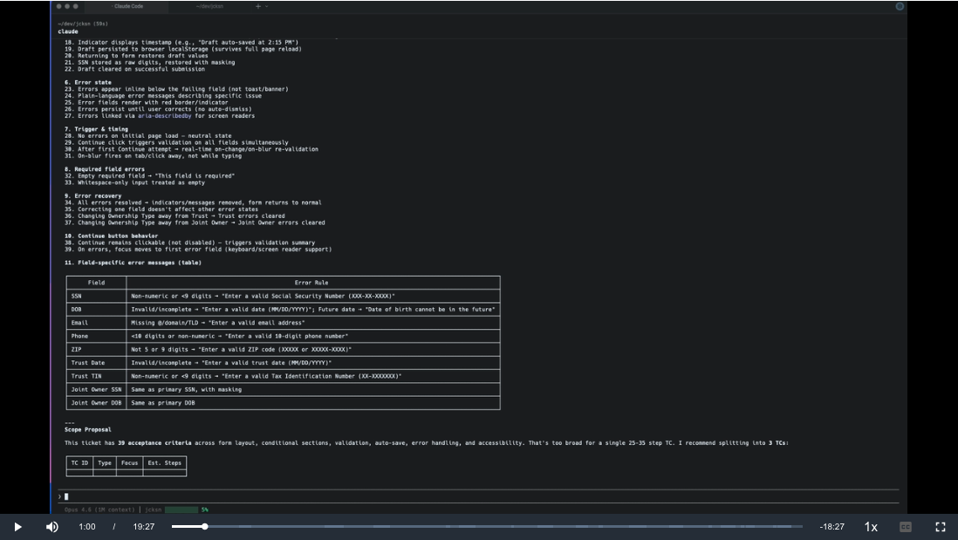
Bounteous’ Agentic QA Framework
Configured for Jackson
PROPOSED NORTH STAR SOLUTION
A reusable scaffold that turns Claude Code into a professional manual test case & automation test case generator and enables:
Self-healing automated test creation and execution across AoE platforms
Reduced manual effort for test script creation and maintenance
Synthetic test data generation across forms, jurisdictions, payment types, ownership scenarios, and exchanges
Automated form comparison, validation, and tagging
Detailed execution reporting with screenshots and diagnostics
CI/CD pipeline integration for automated execution
Secure credential management via Key Vault and API access
Bounteous x Jackson Demo
The video demonstrates processing a sample Jackosn Jira ticket through the Bounteous Agentic QA tool framework to convert the use case to an automated test script.

Slide 5
Proposed solution
Solution Components:
Claud AI: Intelligence Layer
Anthropic Claude (Sonnet 4.6 / Opus 4.7 / Haiku 4.5) powers self-healing locator inference, test authoring co-pilot, synthetic data edge cases, form-tag adjudication, and defect drafting. Accessed via Azure API Management; audit logs, PII redaction, rate limits
Playwright: Execution Core
Deterministic, parallel browser automation with auto-waiting and trace capture. Python (pytest-bdd) and TypeScript variants. Page Object Model at screen-level; matches Jackson's existing testing approach. Runs on Jackson Azure / on-prem agents.
Proposed North Star Architecture
Existing Jackson Systems
Proposed Solution
DELIVERY PIPELINE
AI INTELLIGENCE LAYER
Jackson Forms
& Code Library
QA
Authoring Team
SMEs
(4 platforms)
Jackson InfoSec
/ Legal
Azure API Management Gateway
Audit logs, PII redaction filter, Rate limits , Per-capability quotas, & Anthropic key in Vault
Anthropic Claude
Sonnet 4.6: default (healing, data gen, authoring)
opus 4.7: complex edge cases & form rules
haiku 4.5: high-volume classifications
deployment: anthropic API + AWS bedrock + vertex AI
Authoring Layer
Claude Form-Tag Validator
PDF + XML tag diff, 100+ forms supported, Deterministic checks first, & Claude adjudicates ambiguous diffs
Synthetic Data Generator
Claude Self-Healing Engine
On locator failure: DOM snapshot → Claude →
semantic re-bind → retry → audit log
AI Test Maintenance Agent*
Agent analyzes code base for changes to existing test cases and automation scripts and updates them automatically
Playwright MCP
Azure DevOps CI/CD Pipelines
HashiCorp Vault + CyberArk
Jira-Xray
Allure + Power BI
Playwright Execution Runners
Parallel headless execution on Azure / On-Prem agents
* Please note ”AI Test Maintenance Agent” is now part of the Phase 1 scope and engagement.
Executes against
SYSTEM UNDER TEST - Annuity Order Entry (AOE) Platforms
AN4 — Zinnia
Affirm — iPipeline
Firelight Native — iCapital
Firelight Embedded — Jackson.com

Slide 6
CONTENTS
01
02
03
The Opportunity & Proposed Solution Recap
Proposed Proof of Concept
Next Steps
Notes:
Great at adobe, we understand your business
Value realization that we can drive home

Slide 7
POC
Proposed Proof of Concept (POC)
Before moving forward with the full implementation to achieve the “North Star” architecture, we are conducing a POC aimed to demonstrate AI-driven change detection and test authoring within Jackson’s existing environment, using one the AEO websites experience. The POC will validate three core capabilities from the proposed solution:
Change Detection Agent identifies UI changes by comparing baseline and updated states, then determines whether the change is expected or unexpected
Test Authoring Agent creates or updates the corresponding test case and generates a Playwright script for execution
The demonstration will run for 1 week, leveraging Bounteous’ Cursor, keeping the POC grounded in the AI tool that the Jackson teams typically use.
POC Steps:
Jackson will provide a test case for an existing page/feature on 1 AEO platform
Bounteous to create an automated test script
AI solution executes the test case successfully against the “before” state
Jackson deploys a wanted and an unwanted change to the page/feature
AI solution executes the test case successfully against the “after” states
The AI solution correctly identifies the changes on the selected AEO page (“Change Defection Agent”)
The AI solution flags both changes for manual confirmation
Upon manual confirmation:
    AI updates the test case to reflect the wanted change (“Self-Healing”)
    AI writes a defect on Playwright for the unwanted change (“Test Authoring Agent”)
Deliverables:
Recorded video walkthrough of the POC with voiceover / description
Short summary write-up documenting what was demonstrated and how
Out of Scope:
Backend / API-layer changes — POC is frontend-only
Xray integration — Excel export is sufficient
Committed accuracy or coverage percentages — POC is a demonstration
Notes:
Jennine:
Building on the “day in the life” example we just walked through, this slide illustrates the tangible opportunity for KnitWell the measurable productivity gains that can be achieved through AI enablement and quality empowerment based on our experience and experimentation.
We are seeing a significant impact within the QA function, where automation and AI can drive 30 to 60 percent improvements in overall productivity. This includes major reductions in test maintenance effort, higher pre-release defect detection, and a significant increase in automated regression coverage.
Beyond QA, the benefits extend across the broader delivery organization. Product Managers see improved focus and decision-making — less time spent on reports and documentation, and more time on strategic priorities. Developers, in turn, experience faster turnaround times, fewer debugging sessions, and accelerated documentation creation — all contributing to higher velocity and quality across the SDLC.
Collectively, these gains highlight the multiplier effect of AI in quality engineering — improving not just efficiency, but the overall effectiveness and alignment of every role that touches product delivery.

Slide 8
POC
WIP
Required Access & Information from Jackson
A successful POC requires everything below to be in place before Day 1. All access, environment, and tooling items are Jackson-owned.
Access to Environments & Tooling
Access to a lower / UAT environment for the selected AOE platform (not production)
Jira access to view requirements and test cases for the selected page
Access to any existing Playwright code base (if applicable) to build on top of
Screen recording tool provisioned within the VDI (or Jackson team member on invite to record — per VDI restrictions)
InfoSec approvals needed for the POC scope
Information & Support
Selection of one AOE platform and 1 page/feature
Baseline requirements for the selected page (current state)
Existing test cases or scenarios for the selected page (if available)
Two planned page changes: one announced (expected) and one unannounced (unexpected)
Jackson stakeholders available for demo playback and Q&A at close of POC
Notes:
Jennine:
Building on the “day in the life” example we just walked through, this slide illustrates the tangible opportunity for KnitWell the measurable productivity gains that can be achieved through AI enablement and quality empowerment based on our experience and experimentation.
We are seeing a significant impact within the QA function, where automation and AI can drive 30 to 60 percent improvements in overall productivity. This includes major reductions in test maintenance effort, higher pre-release defect detection, and a significant increase in automated regression coverage.
Beyond QA, the benefits extend across the broader delivery organization. Product Managers see improved focus and decision-making — less time spent on reports and documentation, and more time on strategic priorities. Developers, in turn, experience faster turnaround times, fewer debugging sessions, and accelerated documentation creation — all contributing to higher velocity and quality across the SDLC.
Collectively, these gains highlight the multiplier effect of AI in quality engineering — improving not just efficiency, but the overall effectiveness and alignment of every role that touches product delivery.

Slide 9
CONTENTS
01
02
03
The Opportunity & Proposed Solution Recap
Proposed Proof of Concept
Next Steps
Notes:
Great at adobe, we understand your business
Value realization that we can drive home

Slide 10
Next steps
Proposed Next Steps
Jackson to confirm the POC scope & approach – Today
Bounteous and Jackson agree on the 2 page changes (expected + unexpected) – Targeted for early next week
Jackson completes access, VDI, Cursor licenses, and screen recording provisioning – Targeted for early-mid next week
Joint POC kickoff – Targeted for mid to late next week
Notes:
Jennine:
Building on the “day in the life” example we just walked through, this slide illustrates the tangible opportunity for KnitWell the measurable productivity gains that can be achieved through AI enablement and quality empowerment based on our experience and experimentation.
We are seeing a significant impact within the QA function, where automation and AI can drive 30 to 60 percent improvements in overall productivity. This includes major reductions in test maintenance effort, higher pre-release defect detection, and a significant increase in automated regression coverage.
Beyond QA, the benefits extend across the broader delivery organization. Product Managers see improved focus and decision-making — less time spent on reports and documentation, and more time on strategic priorities. Developers, in turn, experience faster turnaround times, fewer debugging sessions, and accelerated documentation creation — all contributing to higher velocity and quality across the SDLC.
Collectively, these gains highlight the multiplier effect of AI in quality engineering — improving not just efficiency, but the overall effectiveness and alignment of every role that touches product delivery.

Slide 11
Josh Marcus-Donnelly
Zubin Dhingra
VP, Growth (Jackson)
Head of FS, NA
josh.marcusdonnelly@bounteous.com
zubin.dhingra@bounteous.com
440.668.3424
201.657.0402

Slide 12
Proposed solution
Bounteous’ Agentic QA Framework
Existing Jackson Systems
Proposed Solution
Bounteous’ Agentic QA Framework
A reusable scaffold that turns Claude Code into a professional manual test case & automation test case generator.
What it does
Generates structured, executable manual test cases through conversational prompts
Supports 8 test types: Functional, Accessibility (WCAG 2.2), API, CMS Authoring, Regression, Smoke, Integration, Security
Exports to TestRail, Zephyr Scale, Xray, AgileTest, CSV, Markdown, or JSON
Reviews existing test cases and produces enhanced versions with diplomatic, client-ready framing
Ingests context from JIRA tickets, PRs, codebases, Figma, OpenAPI specs, live URLs, and screenshots then references it across multiple TC generations
Creates automated test scripts using Playwright to be executed during regression testing
Synthetic Data Generator
Rules engine over Jackson's field schema
& combinations
Claude Code/AI Intelligence
Sonnet 4.6+ Opus 4.7+Haiku 4.5
Self-healing, Authoring , & Form validation
Playwright MCP
Playwright
Headless parallel execution on Jackson Azure / On-Prem
Claude-powered self-healing on locator failures
Executus against
Annuity Order Entry (AOE) Platforms
AN4 (Zinnia) + Affirm (iPipeline) + Firelight Native (iCapital) +
Firelight Embedded (Jackson.com)

